Slide 1

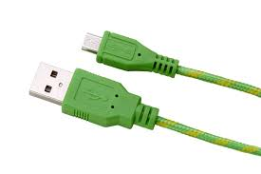




ECO-CHARGER Economical + Eco-Friendly
Indira Gandhi Delhi Technical University for Women
Team Members
Harleen Boparai
Sandeeep Kaur
Jyoti
Deepa

Slide 2
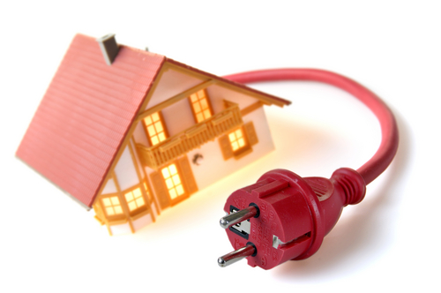
Usual Scenario…..
Recently, many studies have raised concern regarding the UNPLUGGED CHARGERS being the major source of power wastage.
It is a common slip that occurs almost daily and in almost every house. No one bothers to unplug the charger after its use.
A minor step like unplugging the charger when not in use can save Joules of Energy and still Crores of Rupees…..

Slide 3
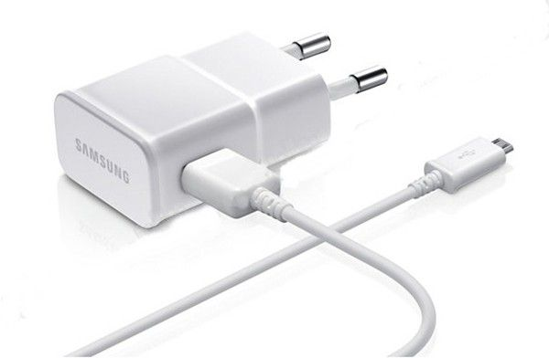
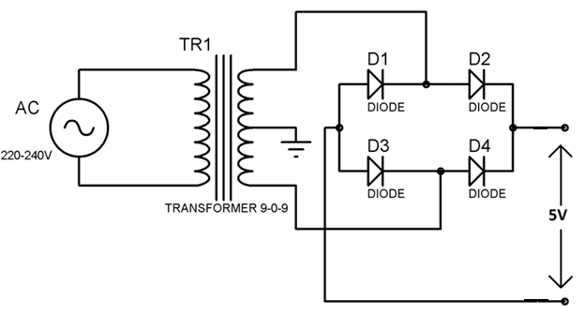
Internal Circuitry of a Mobile Charger
The Internal Components (like transformer, diodes, etc) of a charger continue to consume energy even when not in use, if left unplugged.

Slide 4
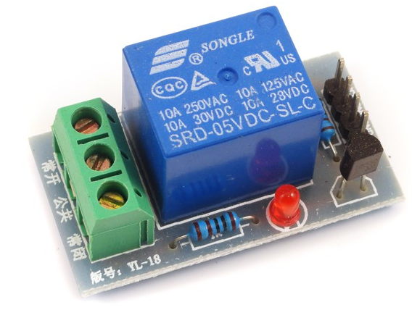
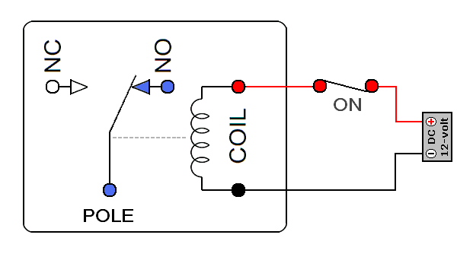
Circuit Diagram of a Relay Shield
So for a solution to this problem we need a Charger which itself cuts off the Power as soon as we disconnect the Smartphone from the Charger.
For this purpose we have made the use of a Relay.

Slide 5
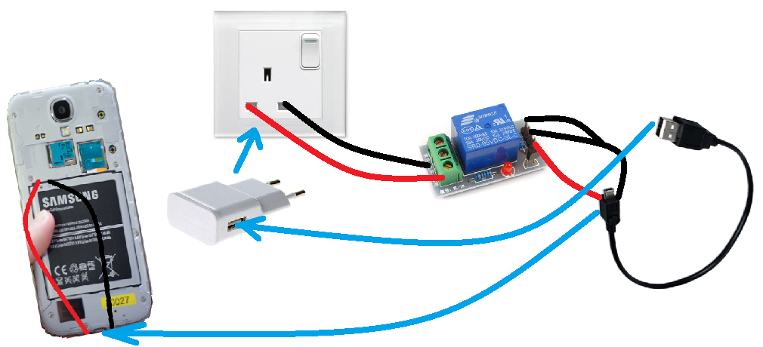
Connections for Eco-Charger

Slide 6

Energy Wastage
A charger draw 0.5 Watt/h when not in use and it cost 3 rupees per kWh.
Assuming that charger is plugged 24 hours a day, 7 days a week over an entire year.
Thus a single charger wastes 45000 kWh per day in Delhi, costing upto 13.14 rupees for a single house .
In Delhi, there are 45 lakh houses ,making upto a wastage of approximately 6 crore .

Slide 7

Advantages of the Product
ECONOMICAL
NO POWER WASTAGE
SAVE ELECTRICITY
SIMPLE CIRCUITRY

Slide 8
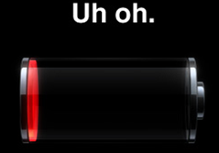
DRAWBACKS
At low voltage(about 0.1V to 0.5V) the battery is not able to power the relay circuit and thus is not able to draw the power so as to charge itself.

